Slide 1
Incremental
Model

Slide 2
Defination.
• In incremental model the whole requirement is divided into various builds.
• Each module (independent units) passes through the requirements, design,
implementation and testing phases.
• The incremental
build model is a method of software development
where
the
product
is
designed,
implemented
and
tested
incrementally
until
the
product
is finished.
Whole requirement
build3
build1
Build2

Slide 3
•
Each
subsequent(coming
after
something
in
time)
release
of
the
module
adds
function
to
the
previous
release.
The
process
continues
till
the
complete
system
is
achieved.

Slide 4
• when we work
piece by piece fully finished.
incrementally we are adding
but expect that each piece
is
Thus keep on
adding
the
pieces
until
1
it’s
complete.
block
block
2
3
block

Slide 5
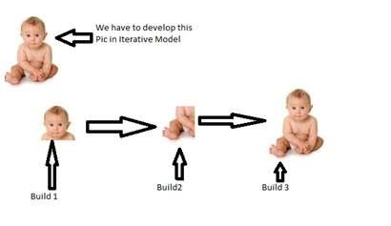

Slide 6
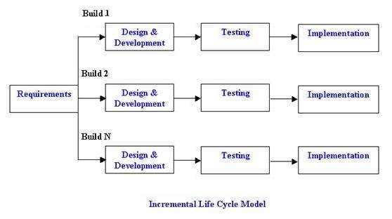
Incremental development model:

Slide 7
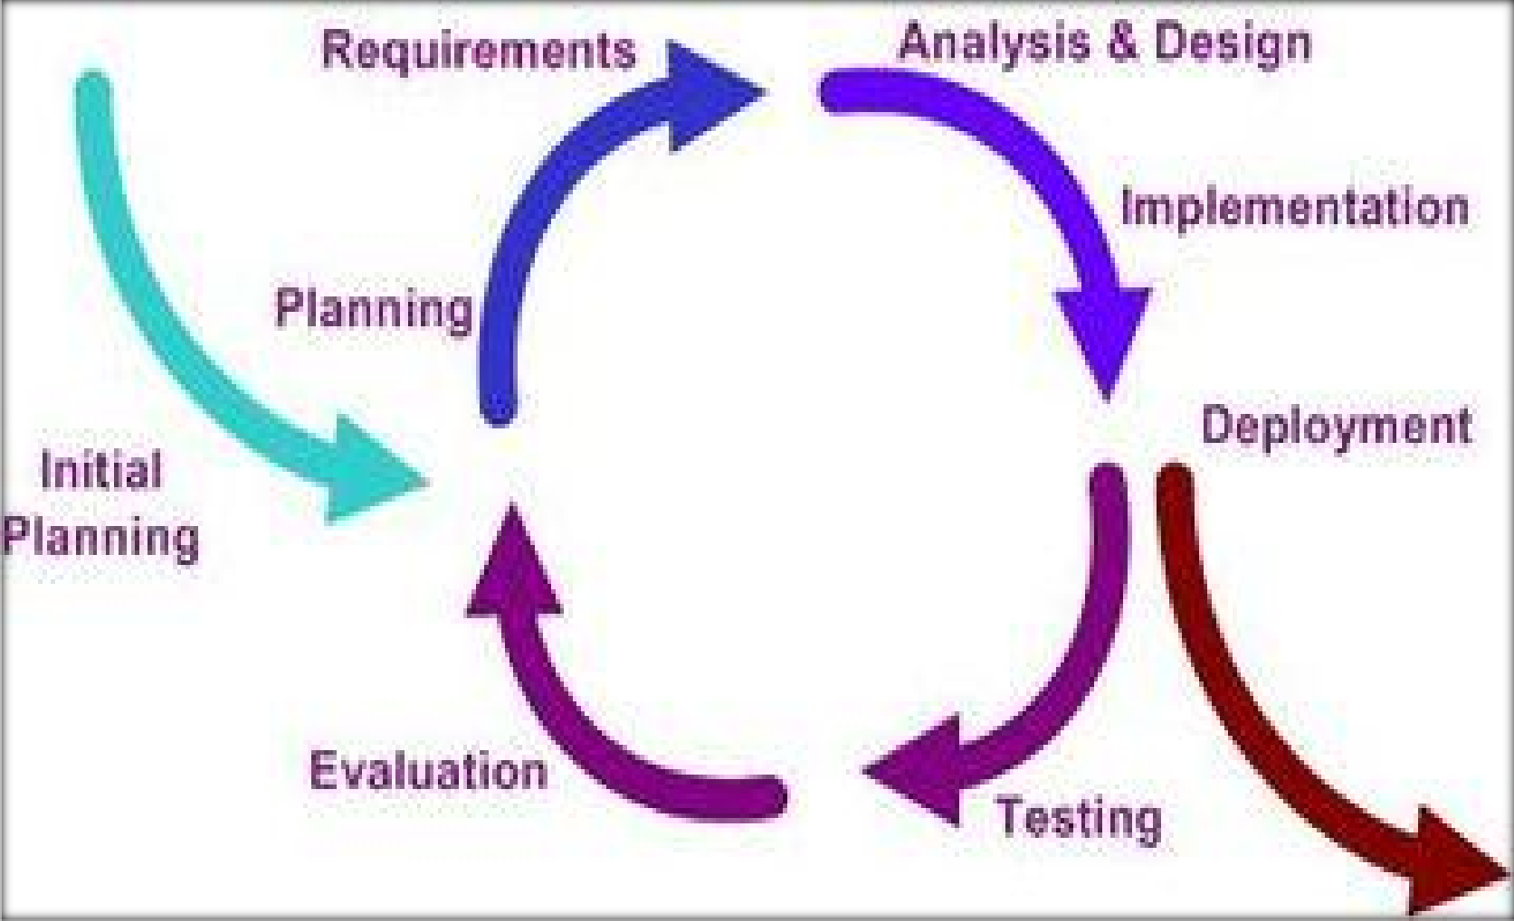
INCREMENTAL MODEL LIFE CYCLE

Slide 8



THE INCREMENTAL MODEL
 increment #n
Software functionality and features
planning
Modeling analysis design
Construction
code test
Deployment
delivery feedback
 Increment #2
Delivery of nth increment
planning
Modeling analysis design
 Increment#1
Construction
code test
Deployment
delivery feedback
Delivery of 2nd
increment
planning
Modeling analysis design
Construction code test
Deployment delivery feedback
Delivery of 1 st increment
Project calendar time

Slide 9
INCREMENTAL MODEL LIFE CYCLE
 It basically:
 divides the overall project into a number of increments.
 Then it applies the waterfall model to each increment.
 The system is put into production when the first increment is delivered.
 As time passes additional increments are completed and added to the working system
 key process are to start with a simple implementation of a subset of the software requirements and iteratively enhance the evolving sequence of versions until the full system is implemented.
At each iteration, design modifications are made and new functional capabilities are added.
Notes:
 Phases on each increment are sequential.

Slide 10
When
to use
the
Incremental
model:
• This model can be used
of the complete system understood.
when the requirements
are clearly defined and
• Major requirements must be defined; however,
some details can evolve with time.
• There is a need to get a product to the market
early.

Slide 11
Advantages
of Incremental
model
• Generates working software quickly and early during the software life cycle.
• This model is more flexible – less costly to change scope and requirements.
• It is easier to test and debug during a smaller iteration.
• In this model customer can respond to each built.
• Lowers initial delivery cost.
• Easier to manage risk because risky pieces are identified and handled during it’s iteration.

Slide 12
Disadvantages
of
Incremental
model:
• Needs good planning and design.
• Needs a clear and complete definition of the whole system before it can incrementally.
• Total cost is higher than waterfall.
built
be broken down and

